Slide 1
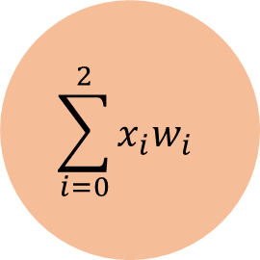
1
W0 = bias
$$\sum_{i=0}^{2}{x_{i}w_{i}}$$
Activation
Threshold
X1
W1
Prediction Label
Default: TanH
> 0 for TanH for (+) Class
X2
W2
Possible Activation Functions:
Sigmoid, TanH, Linear, ReLU
© Mohsen Ebadpour

Slide 2
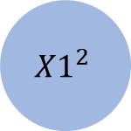

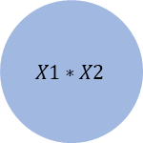
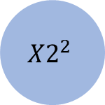
1
X1
X2
$$\sum_{i=0}^{2}{x_{i}w_{i}}$$
Activation
Threshold
Prediction Label
$${X1}^{2}$$
Default: TanH
> 0 for TanH for (+) Class
Possible Activation Functions:
Sigmoid, TanH, Linear, ReLU
$${X2}^{2}$$
$$X1∗X2$$
© Mohsen Ebadpour

